Slide 1
Interpretation of the Chinese Community Governance Model: The Mechanism and Joint Effort of Community, Social Workers and Social Organizations(S+C+C)
Wu Danxing
Ph.D of Medicine Monash University
Member of the Expert Committee of Age Care Civil Affairs Ministry of PRC
Executive Dean of the Social Work College of the Open University of China
Executive Director of the China Association of Social Workers
Director of Social Work Occupational Skills Certification Center

Slide 2
Reality in China
Keeping growth, adjusting structure
China’s economic decline significantly,
Overcapacity in almost every industry
Chase new and sunrise industries,
The core of economic
Transformation – the service industry
Hard Bottom
Healthy elderly service industry --- one of the development direction

Slide 3
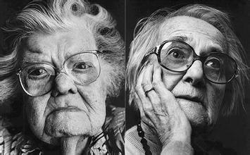
When aging population meets:
Economic slowdown and overcapacity
Real estate step into silver age
Parents of the one-child get old
Social culture moral confusion
Social development structure changes

Slide 4
“The 12th Five-Year Plan”– Elderly Service Development Strategy Goals
“9073”
Nursing
Home
Home
Care
90%
Institutional
Care
3%
Community
Care
7%
Home care as the base
Community care as the support
Institutional care as the supplement

Slide 5
Home Care
Family Care
Domestic Service
Day-care
Community Service
Community Service Station
CCRC
Elderly Care Institution
Nursing Home

Slide 6
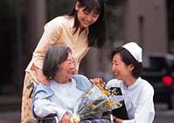
The National Pension Resource Allocation Center --- Community
Domestic Service
Community hospital
Community
Self-care
Disability
Community Center
Community Nursing Center
Short-term care
Day-care center
Semi- Self care

Slide 7
The Transformation of Chinese Community
Social Management under old model
“System of Units”
Integrated society
Sense of belongings to Organization
Lack sense of belongings to community
Centralized power/ administrative system
Individual Citizens
Management through “units”

Slide 8
Social Governance under new model
“System of units" gradually collapse
“System of community" needs increase
Sense of belongings to society
Sense of belongings to community
Back to the society and residential place
Individual Citizens
Urgently need new carrier platform

Slide 9
“Social Management”to“Social Governance”？
Management
Governance
Government
Non- negotiable
Power
Mandatory
obedience
Community Residents
Negotiation &
Collaboration
Multilateral Governance
Consultation Governance
Social Organizations
Social Management---the provision of Public Products and Services
1----Government Coordination “Government failure”
2----Market Manipulation “Market failure”
3----NGOs-led “Voluntary failure”

Slide 10
Structural change in social governance？
State governance
Social governance
State of Law
Protect private property and civil rights
Community governance
Society governed by law
Civil Society
Civil Autonomy
“Community+Social Workers + Social Organizations”
Residents Autonomy
Social Organizations Participation

Slide 11
Committee of Residents
Community Residents
Community
Social Organization
Social Workers

Slide 12
“S+C+C” is an innovative community governance model developed by our community social work from their daily practices, it aims to unite communities, social organizations and social workers for coordinated interaction and joint force.
Community
as platform
“S+C+C”
Social Organization
as carrier
Social Workers
as support
“S+C+C” model is led by the government, communities as platform, social organizations as carrier, and social work professionals as support to realize the “S+C+C” mutual support and coordinated interaction.
“S+C+C” is an innovative model of community governance, it is the ideal state for future community governance.

Slide 13
Social Workers
Social workers are a profession with social work knowledge and certain competencies, providing innovative work in the social service field
Social workers
In western countries, deemed as “social engineer”, “social doctor”
In China, seen as
“low status”, “dispensable and optional”
In <<The Outline of National Medium and long-term talent(2010-2020)>> issued in 2010 has clearly stated that, social workers are for the first time in history listed as a independent talent profession, and by 2020, social workers will be reached to a number of 3 millions. (At present the number of social workers is 500 thousands).
In 2011, the Ministry of Civil Affairs issued <<Opinions on Strengthening Construction of Social Work Professionals>>, it is the first exclusive document for social workers from the central government, indicated the importance of social work in the new era of social governance.

Slide 14
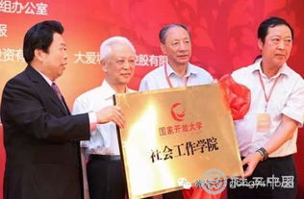
The China Open University Social Work School
Established in November 26th 2013, fall 2016 opened major in Community Management and Service. Employed personnel can apply and register to study, program length is 2.5 years, status can be kept for 8 years. Academic record will enter into the credit bank, when meet the credit requirement, would receive associate degree which is recognized by the Ministry of Education, meanwhile students would receive the certificate of Registered Gerontological Social Workers Occupational Skills.
The biggest university in China
Nearly 4 million students registered
2016- Dual certificate online courses:
<<Community Management and Service>>
Associate degree education
<<Registered Gerontological Social Workers>> Occupational Skills Certificate

Slide 15
The Objectives of the “S+C+C” model?
“Give back to the community what belongs to them”
1
As for the individual residents, to increase the level of welfare and strengthen the internal capacity
As for the community, to fully realize democracy, to build governance structure, and building the community as a common living space
2
As for the government, to reduce interventions in
community management, ensure the stability of public
order by the realization of the above two objectives
3

Slide 16
The transition of community service model
Welfare service
Low-interest service
For-profit service
Welfare
Low-interest
Moderate profit
Old model
Broad coverage, low standard, meet the basic needs
New model
Broad coverage, high standard, meet the needs for
high quality life
Opportunity for all to live in high-quality life

Slide 17
Communities in the past has “multiple controls” but wasn’t united and connected
Women & Children Committee
Civil Affairs
Human Resources
Disabled Federation
Health
Community platform---all forces formed own system and run independently
Build the modernization of the state governance system and governance capacity needs
Divided administrative management—no longer meet the needs of social development
Comprehensive Management of Community, integrated utilization of resources---become inevitable in development

Slide 18
“S+C+C”—— Integrates divided resources
Women & Children Committee
Civil Affairs
Human Resources
Disabled Federation
Health
Community platform——purchasable social service
Elderly care
Medical care
Convenience
Aiding disabled
Nursery

Slide 19
The nature of social service – what does it emphasize on?
A relation-ship
A process
A division

Slide 20
Government transfer social service providing
Social organization undertaking social service
1.Long-term transition process
2.The gradual implementation process
3.Process of value convergence
4.Social cognition identification process
5.Process of completed payment transfer
6.Process of resource allocation
7.Process of coordinated development
8.Realization of Win-Win
1.Process of participation
2.Process of gradual growth
3.Process of value convergence
4.Process of team-building
5.Process of the quality service improvement
6.Process of completed operational cycle
7.Process of replication capability formation
8.Realization of Win-Win

Slide 21
China Association of Social Workers
Occupational Skills Certificate center of Social Work
Social Work College
China Association of Social Workers platform（by 2020, 1.45 million social workers）
Social organization
Social enterprise
Philanthropy

Slide 22
Development of social service in China
—— Breakthrough the Bottleneck
Personnel sustainability
Development mode sustainability
Independent operation sustainability
Pure commercial path--- Against the essence of social services
Pure governmental path--- Lacking sustainability
Pure non-profit path– Non-survival mode

Slide 23
Conventional Public Welfare concept
Aid
Charity
Humanitarian
Donation
Produced a group of rich
Made a group of poor
New public welfare concept--- Implant “public welfare” into modern commerce
New Public Welfare concept
Nurture social enterprise
Improve social welfare

Slide 24
Social needs
Social enterprise
Social welfare
1、Philanthropy Work --- Market Oriented operation
2、Non-profit --- social welfare as the mission
3、Requires Government Support --- But Independent and Sustainable
4、Philanthropy Support --- Establish Fundraising Mechanism
5、Volunteer Team --- Establish well-trained service team

Slide 25
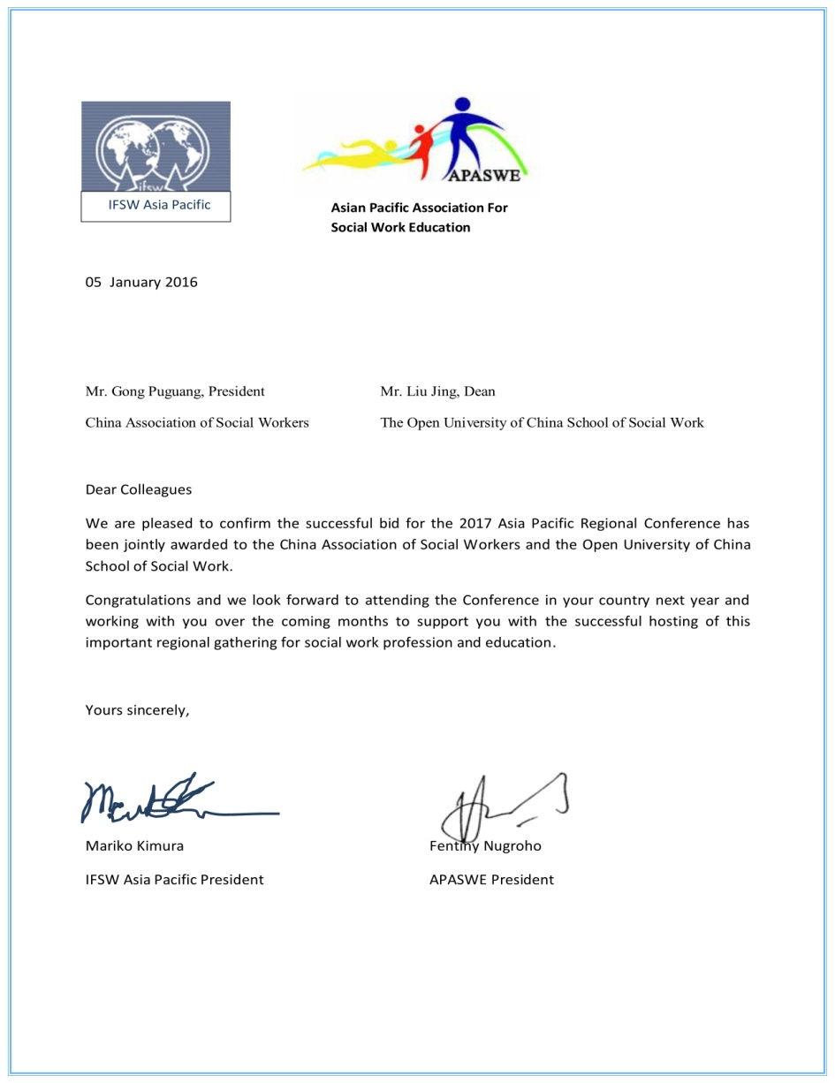
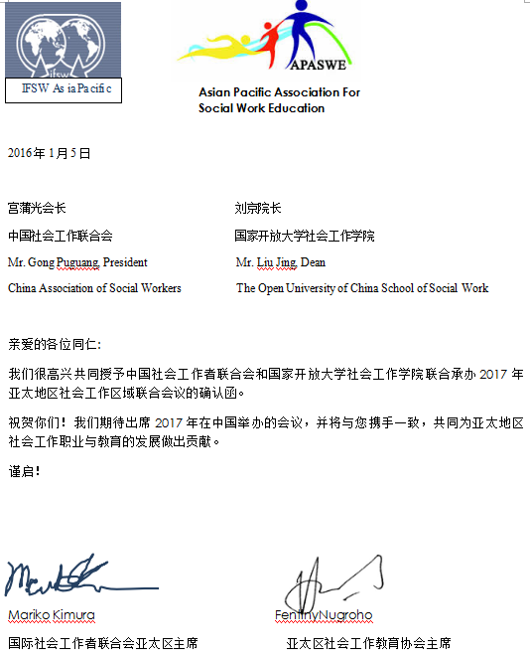
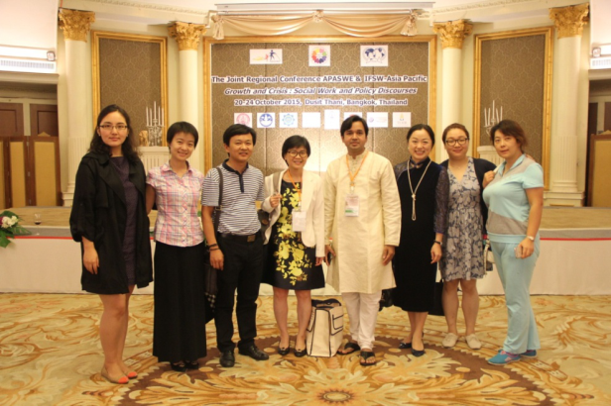
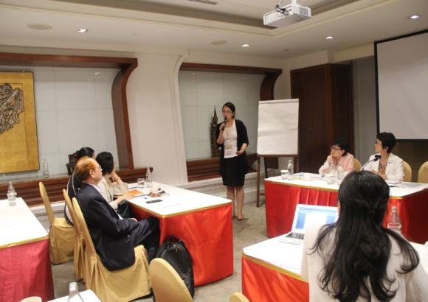
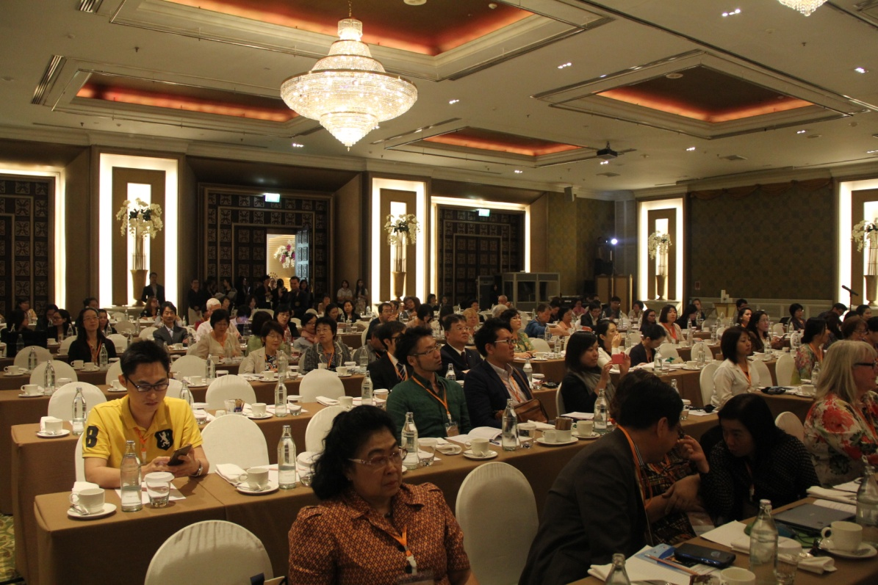
Successful bid on 2017 Asia-Pacific Joint Regional Social Workers Conference

Slide 26
Thank you!

